Slide 1
Topics for our eco action plan

Slide 2


Slide 3


Slide 4
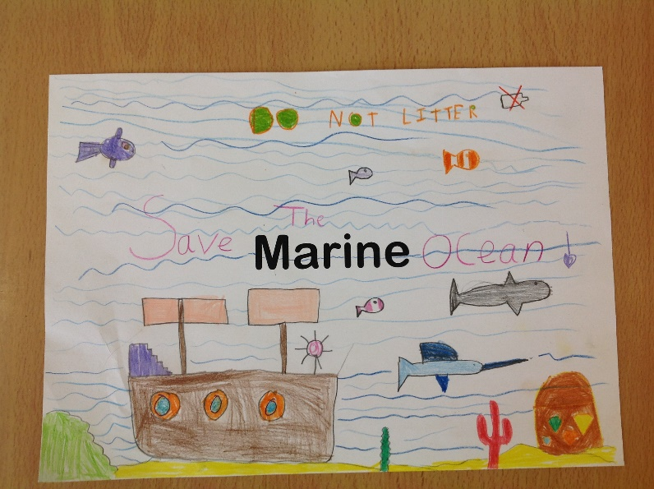

Slide 5
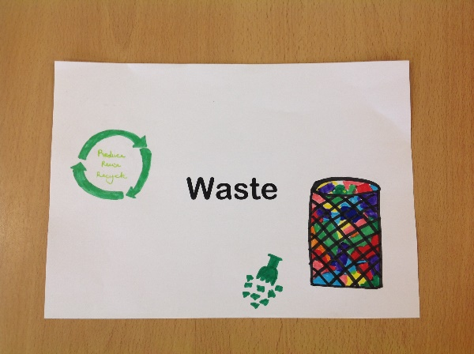

Slide 6


